Slide 1


Department of Computer Science and Engineering
EMPOWERING CONSTRUCTION WORKERS SAFETY THROUGH REALTIME
PROTECTIVE EQUIPMENT MONITORING AND ALARM SYSTEM
Dr. Senthil Pandi S
Assistant Professor(SG)
B21A2425C17
210701150 Manojkanna K
210701153 Maria Joshin M

Slide 2
Problem Statement and Motivation
Safety management methods are often reactive, relying on manual checks and post-incident interventions, which can lead to accidents and injuries due to non-compliance with safety regulations. The absence of a system that can continuously and automatically detect whether workers are wearing essential protective gear, such as hats, masks, and vests, increases the potential for hazards.
The motivation for this project is to improve construction site safety by overcoming the inefficiencies of manual inspections, which often miss safety violations. The project aims to create an automated system that can detect non-compliance with safety gear in real-time and provide immediate alerts.

Slide 3
Objectives
Ensure consistent PPE compliance among construction workers to reduce accidents and fatalities.
Develop a real-time monitoring system using the YOLOv8 model for accurate safety detection.
Provide immediate alerts for violations, enabling prompt corrective actions on-site.
Promote a culture of accountability and prioritize worker health and safety in diverse environments.

Slide 4
Abstract
Failure to wear PPE, such as helmets and vests, causes preventable accidents and injuries in the construction sector.
Our system uses advanced detection to monitor real-time PPE compliance, ensuring workplace safety.
Audible alarms notify workers of violations, enabling immediate corrective actions and reducing risks.
The project fosters a safety-first culture, aiming to minimize accidents and protect workers' lives.

Slide 5
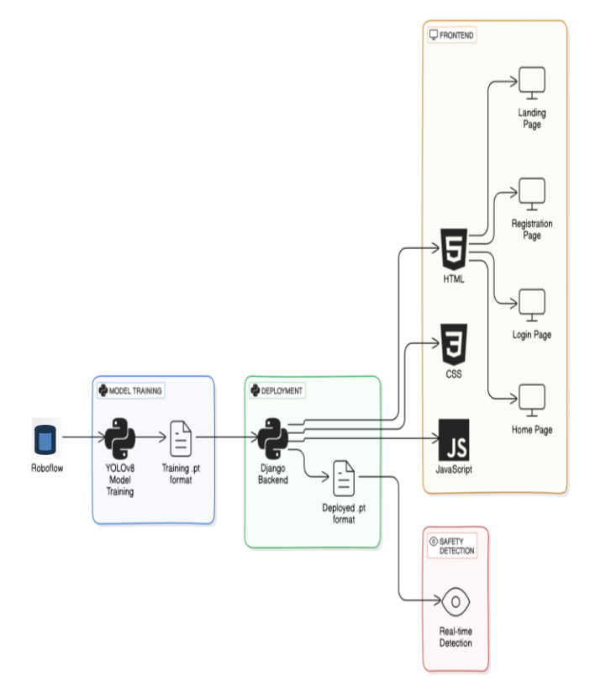
System Architecture

Slide 6
List of Modules
Slide 7: Functional Description for
Data Collection:
Model Training:
Model Testing:
Obtaining model.pt :
Deployment:

Slide 7
Functional Description for each modules with DFD and Activity Diagram
Data Preprocessing:
Augmented the dataset using affine transformation, random erase, grid mask, and mosaic to improve generalization.
Normalized and labeled PPE elements to ensure consistency and quality for accurate model training.
Model Training:
Optimized YOLOv8 by adjusting hyperparameters like learning rate, batch size, and epochs for better performance.
Focused on precision, recall, and mAP metrics to enhance PPE detection accuracy and classification .

Slide 8
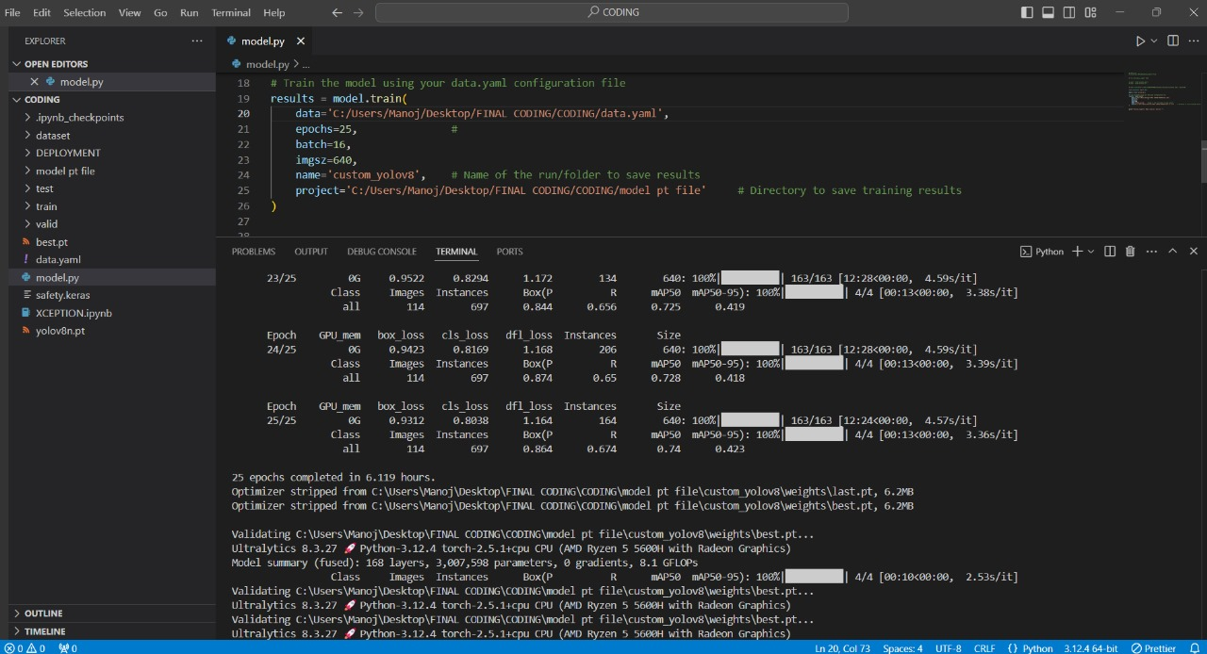
Implementation & Results of First Module
First Module: Data Preprocessing and Exploratory Data Analysis
Results:

Slide 9
Conclusion & Work for Phase II
The initiative addresses PPE non-compliance in construction, a major cause of accidents and fatalities.
It uses a YOLOv8-powered real-time monitoring system to ensure workers consistently wear required safety gear.
Immediate auditory alerts notify individuals of safety violations, promoting accountability and adherence to protocols.
The system employs advanced data techniques, ensuring accuracy and versatility across diverse environments.

Slide 10
References
[1] Zhao, Y., et al. "Deep Learning-Based Framework for Safety Equipment Detection." *Journal of Construction Engineering and Management*, vol. 145, no. 4, 2019, pp. 1–10.
[2] Singh, R., and Kumar, A. "Enhancing Safety Gear Detection Using Deep Learning." *International Journal of Advanced Research*, vol. 8, no. 6, 2020, pp. 25–31.
[3] Dhiravidachelvi, E., Devadas, T. J., Kumar, P. J., and S. S. Pandi. "Enhancing Image Classification Using Adaptive Convolutional Autoencoder-Based Snow Avalanches Algorithm."

Slide 11
Paper Publication Status
Completed

Slide 12
Thank You

